Slide 1
Parameter-Efficient Transfer Learning for NLP
(Houlsby and al. 2019)
Article presentation by Weiqi ZHANG

Slide 2
Plan
About the project
Research team & members
Context & background
Objective
Theoretical innovation
  What is a Transformer
  What is a BERT
  What is an adapter module
Empirical experiments
  Corpora I
  Models used
  Results
  Corpora II
  Models used
  Results
  Corpus III
  Results
Further analysis
Conclusion
Discussion

Slide 3
About the project
Proceedings of the 36th International Conference on Machine Learning, Long Beach, California, PMLR 97, 2019. Copyright 2019 by the author(s).
Equal contribution Google Research and Jagiellonian University. Correspondence to: Neil Houlsby <neilhoulsby@google.com>.
Code on github
4120 citations according to Google Scholar

Slide 4
Research team & members
From Google:
Neil Houlsby
Andrei Giurgiu on Linkedin
From Jagiellonian University:
Stanisław Jastrzȩbski

Slide 5
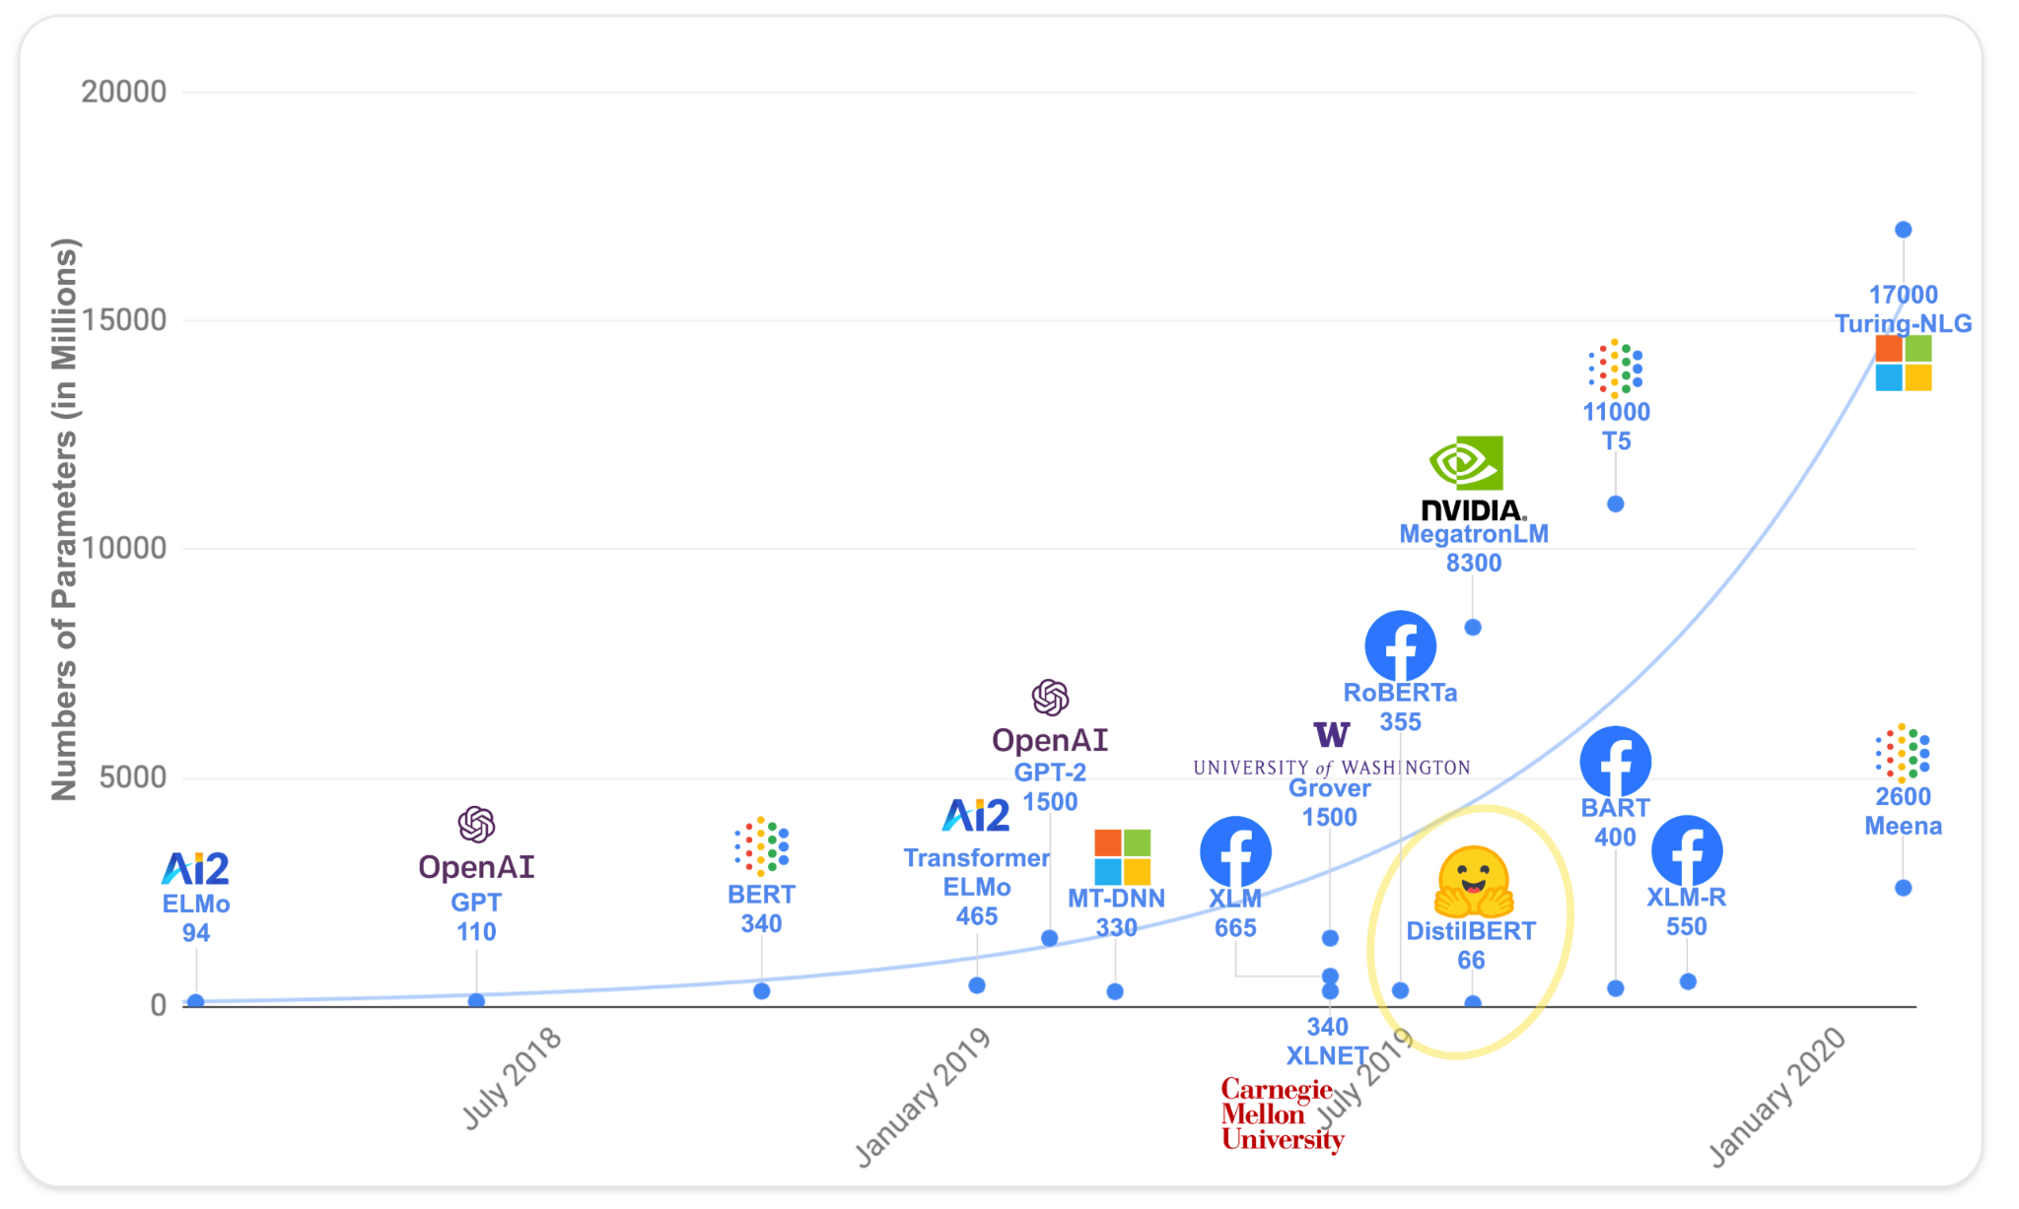
Context & background - history of LLM
Article published in July 2019
Image from HuggingFace

Slide 6

Context & background - role playing game…
Imagine that you are a ML engineer in a company
One day, your product manager finds you a dataset called ***CoLA*** and asks you to do a classification job
What shall you do?
Just use ChatGPT?
Fine-tune a BERT

Slide 7
Just use ChatGPT?
You got fired because everyone knows how to use ChatGPT and I don’t see the point of hiring an extra engineer
Also because ChatGPT does not exist in 2019 ╮(╯∀╰)╭

Slide 8

Fine-tune a BERT
You successfully accomplished the task and the product manager seems satisfied
The next day, your product manager finds you a dataset called ***SST*** and asks you to do a syntaxe annotation job
What shall you do?
Use ChatGPT
Fine tune another BERT

Slide 9

Fine tune another BERT
You successfully accomplished the task and the product manager seems satisfied
The next day, your product manager finds you SEVEN dataset called
  MRPC
  STS-B
  QQP
  MNLIm
  MNLImm
  QNLI
  RTE
and asks you to do a bunch of jobs
What shall you do?
Fine-tune 7 BERT
SHOOT the manager!!!

Slide 10
Wait…
Our problem:
is not that the product manager gives us to much work…
is that Fine-tuning is boring, repetitive and ***parameter inefficient***
Fine-tuning will change all the weights in an LLM and it is only good for this one downstream task
Imagine that you host a cloud service, with a model of 100B parameters and 40G
You have 10,000 clients
Create and save 10,000 copies of fine-tuned models?

Slide 11
Objective
Finding alternatives to “vanilla fine-tuning” or other parameter inefficient methods (e.g. feature-based transfer)
Hence our paper: Parameter-Efficient Transfer Learning for NLP!

Slide 12
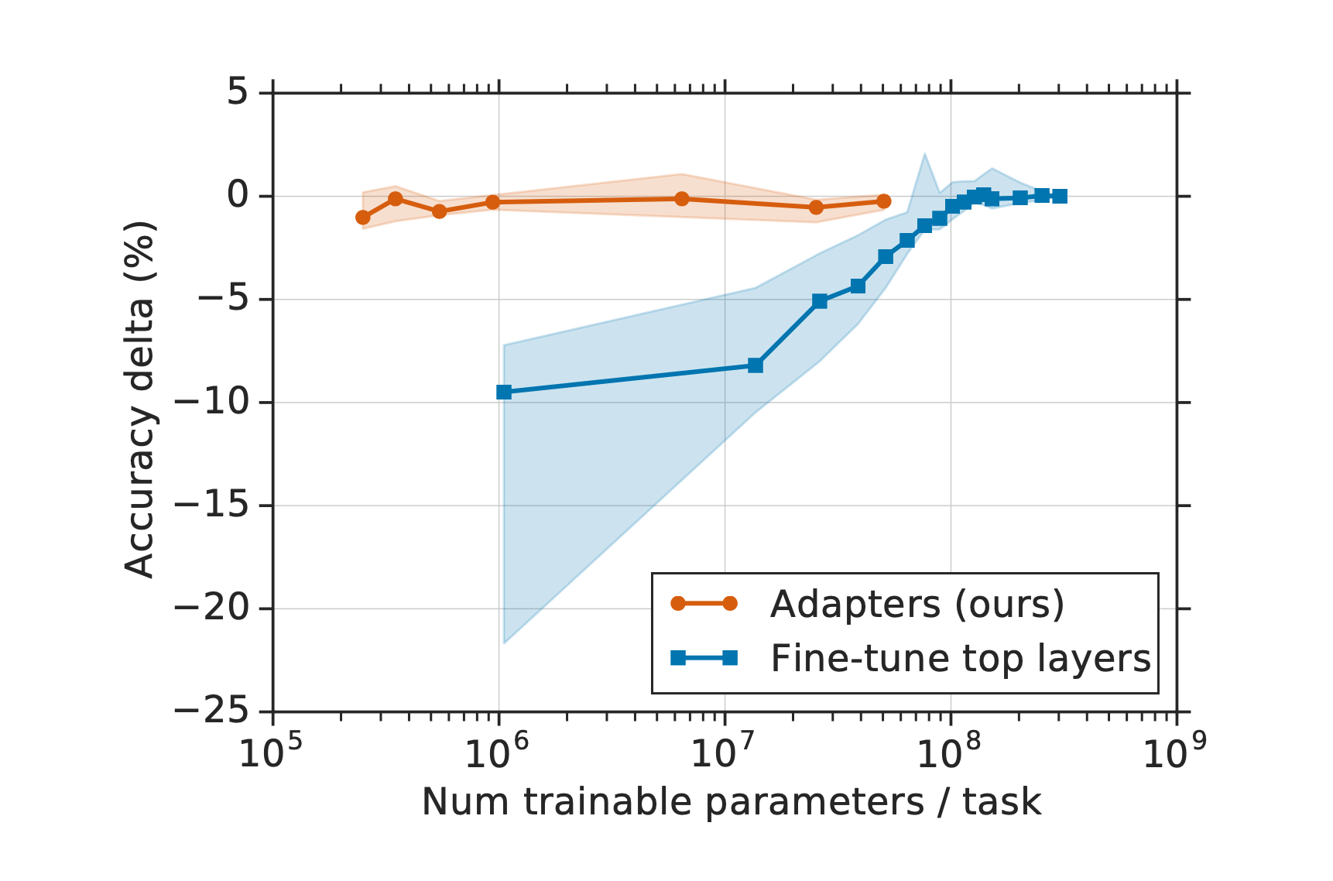
Objective
But our objective is NOT to prove that our method is systematically better than vanilla fine-tuning
Instead, we are looking for a trade of between parameters/performance
Spoiler:

Slide 13
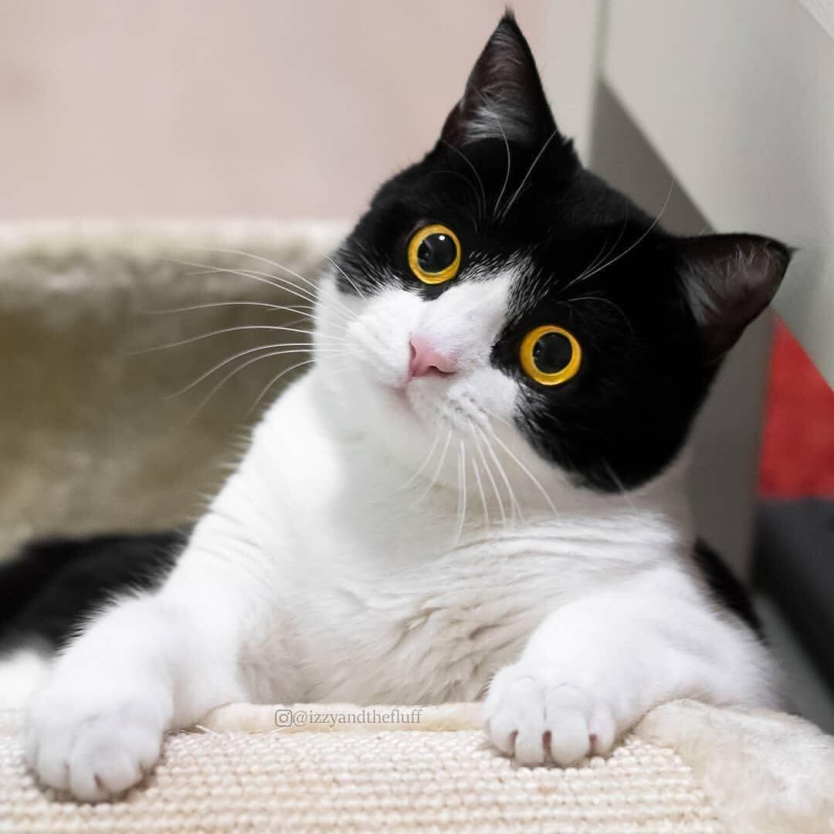
What did the paper do? - Theoretical Part
In one sentence: they propose an ***bottleneck structure adapter module*** and place it all over the BERT
When “fine-tuning” the model, only weights of the adapters are updated, the original weights are freezed
But what is a “bottleneck structure adapter module”?

Slide 14
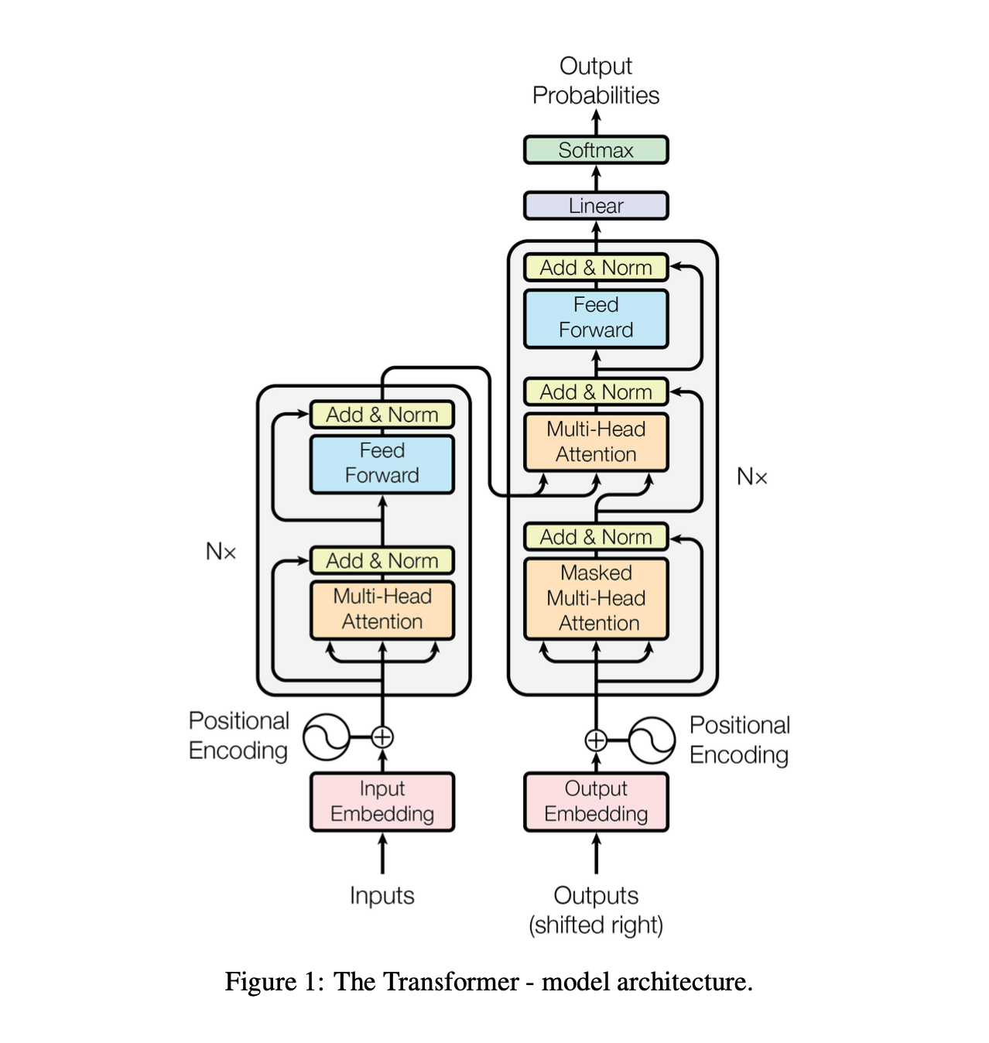
Architecture of a Transformer model
In the original Transformers
6-stack encoders
6-stack of decoders
BERT
12-stack encoders
hidden_size=768, num_hidden_layers=12, hidden_act="gelu",

Slide 15
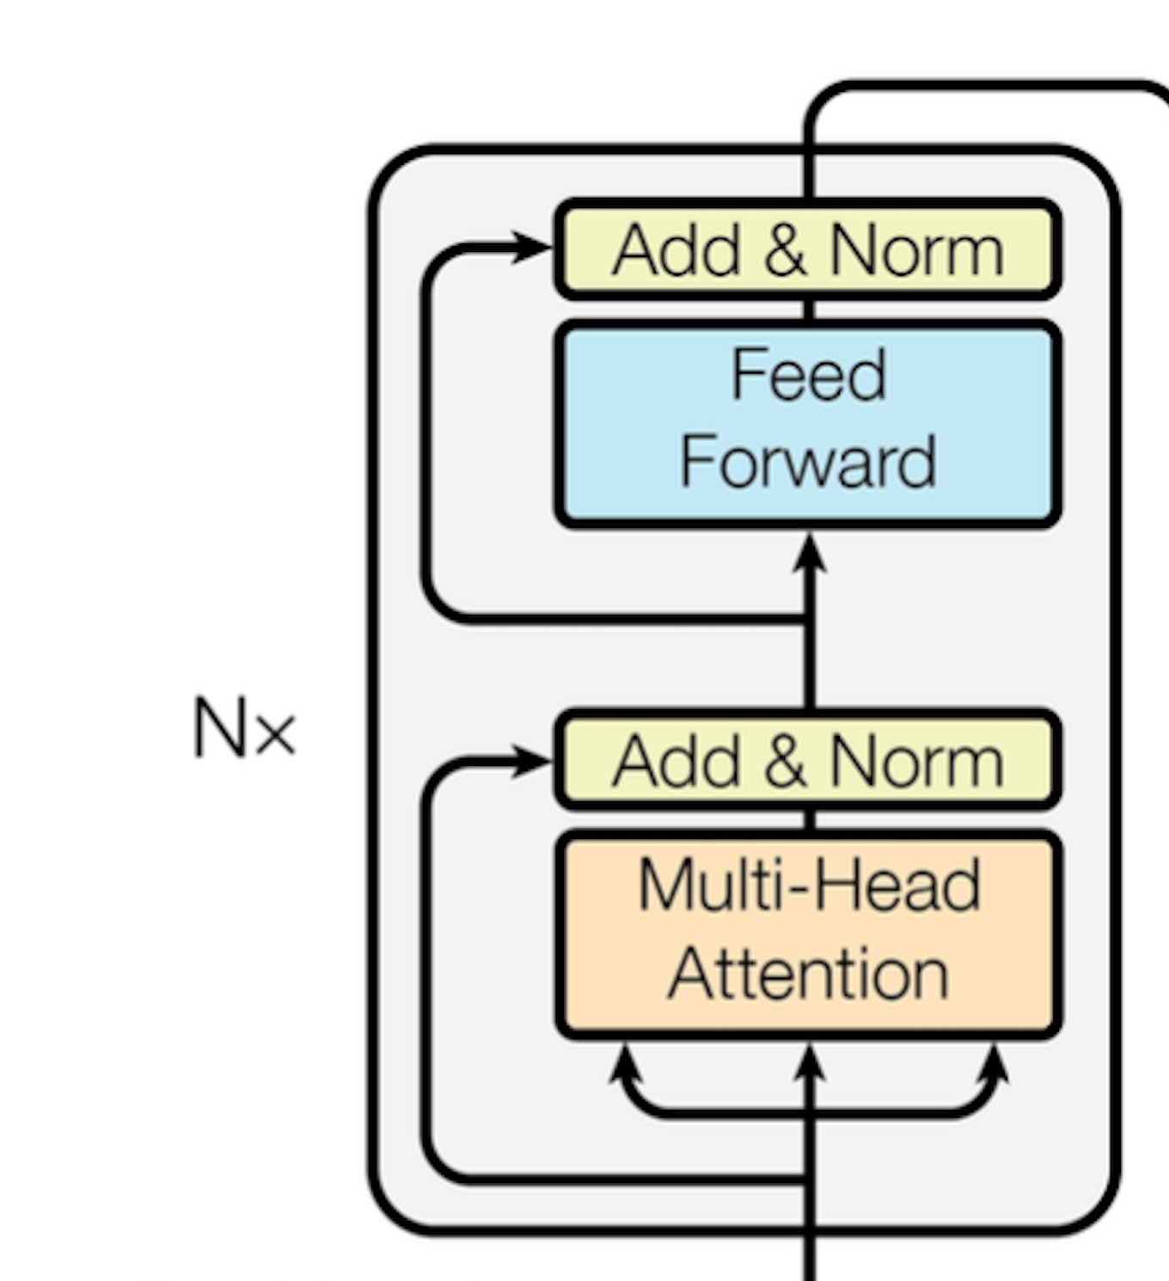
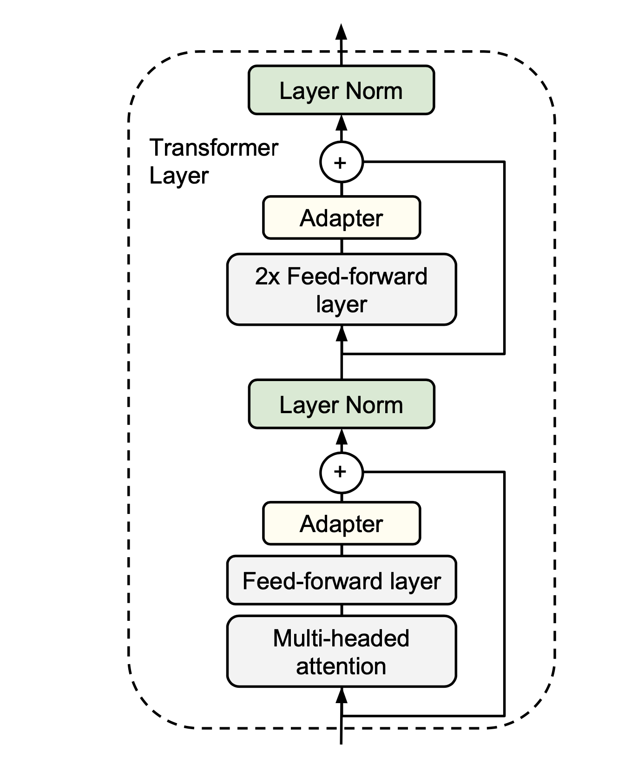
Comparison with a BERT with adapters

Slide 16
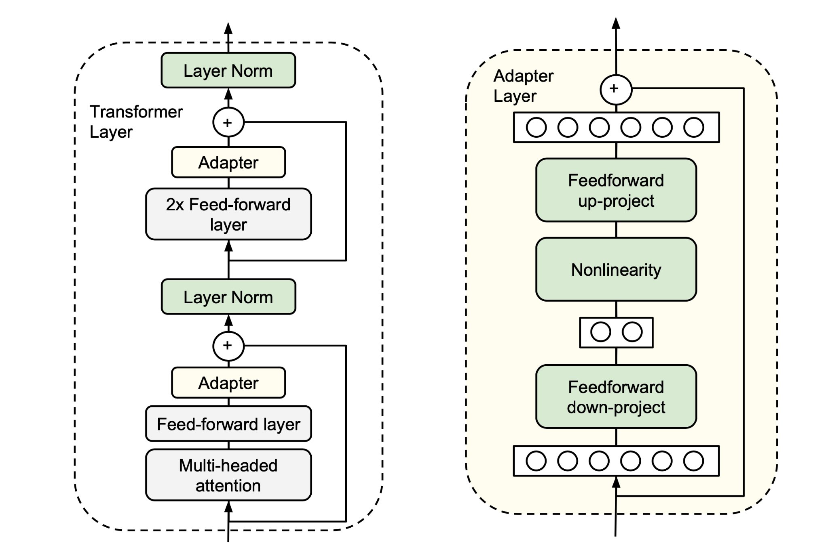
The adapter module
hidden_size=768,
num_hidden_layers=12,
hidden_act="gelu",
Adapter size choice:
{8, 64, 256}

Slide 17
Empirical experiments - Corpora I
GLUE benchmark - a collection of NLU tasks
  CoLA
  SST
  MRPC
  STS-B
  QQP
  MNLIm
  MNLImm
  QNLI
  RTE

Slide 18
Empirical experiments - Corpora I - Models
BERT - LARGE
BERT with adapters (8-256)
BERT with adapters (64)

Slide 19
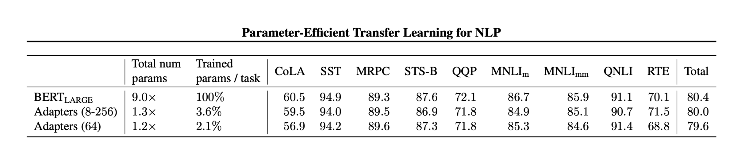
Empirical experiments - Corpora I - Results
Over all, BERT LARGE yields slightly better results
But there are small variations and cases where adapters are better
Different adapter sizes don’t matter much: We find that the quality of the model across adapter sizes is stable, and a fixed adapter size across all the tasks could be used with small detriment to performance. (3.6)

Slide 20
Empirical experiments - Corpora II
20 newsgroups
Crowdflower airline
Crowdflower corporate messaging
Crowdflower disasters
Crowdflower economic news relevance
Crowdflower emotion
Crowdflower global warming
Crowdflower political audience
Crowdflower political bias
Crowdflower political message
Crowdflower primary emotions
Crowdflower progressive opinion
Crowdflower progressive stance
Crowdflower US economic performance
Customer complaint database
News aggregator dataset
SMS spam collection

Slide 21

Empirical experiments - Corpora II - Models
This algorithm searches over a space of feedforward and convolutional networks, stacked on pre-trained text embeddings modules publicly available via TensorFlow Hub.
For each task, we run AutoML for one week on CPUs, using 30 machines.
In this time the algorithm explores over 10k models on average per task. We select the best final model for each task according to validation set accuracy.

Slide 22
Empirical experiments - Corpora II - Models
BERT - BASE
BERT - BASE Variable FT (i.e. only fine-tune top layers of BERT)

Slide 23
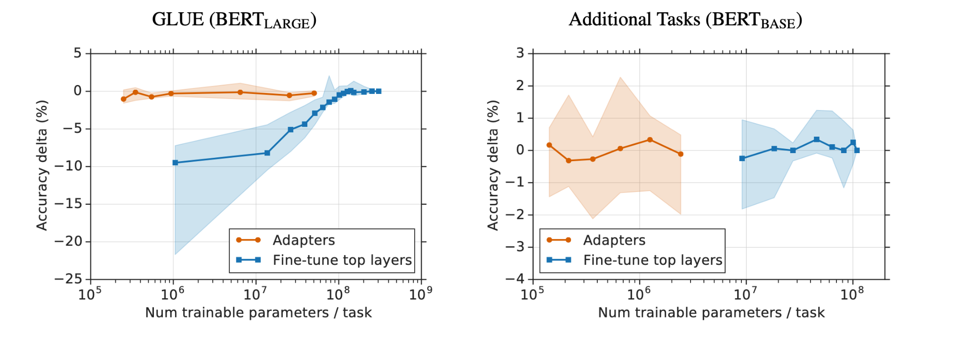
Empirical experiments - Results
Adapters achieve comparable results while only tuning roughly 1% of parameters

Slide 24
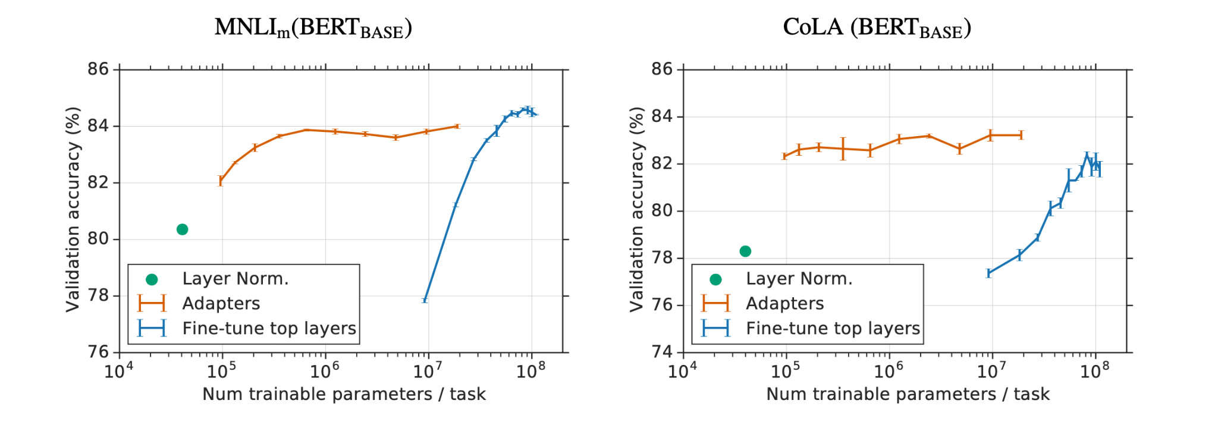
Empirical experiments - More details
When fine-tuning using a comparable number of task-specific parameters, the performance decreases substantially compared to adapters.

Slide 25
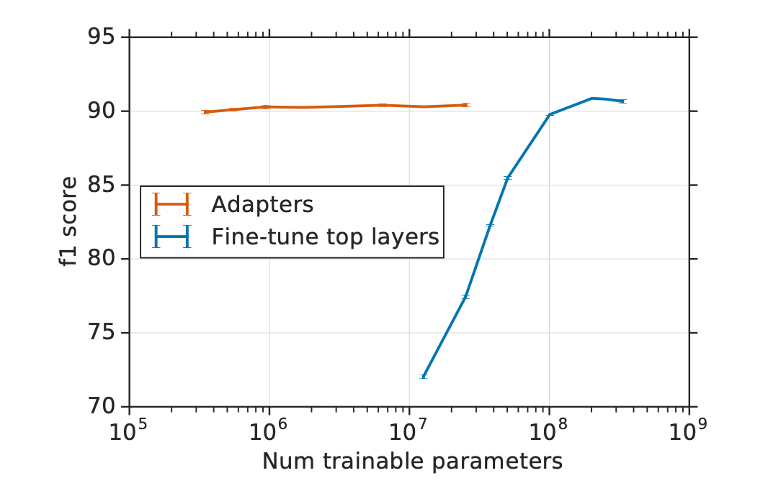
Empirical experiments - Corpus III
SQuAD v1.1
Given a question and Wikipedia paragraph, this task requires selecting the answer span to the question from the paragraph.
Shows that adapters don’t work only on classification tasks.

Slide 26
Further analysis
Which adapters are actually working?
Try removing some adapters to see performance change?

Slide 27
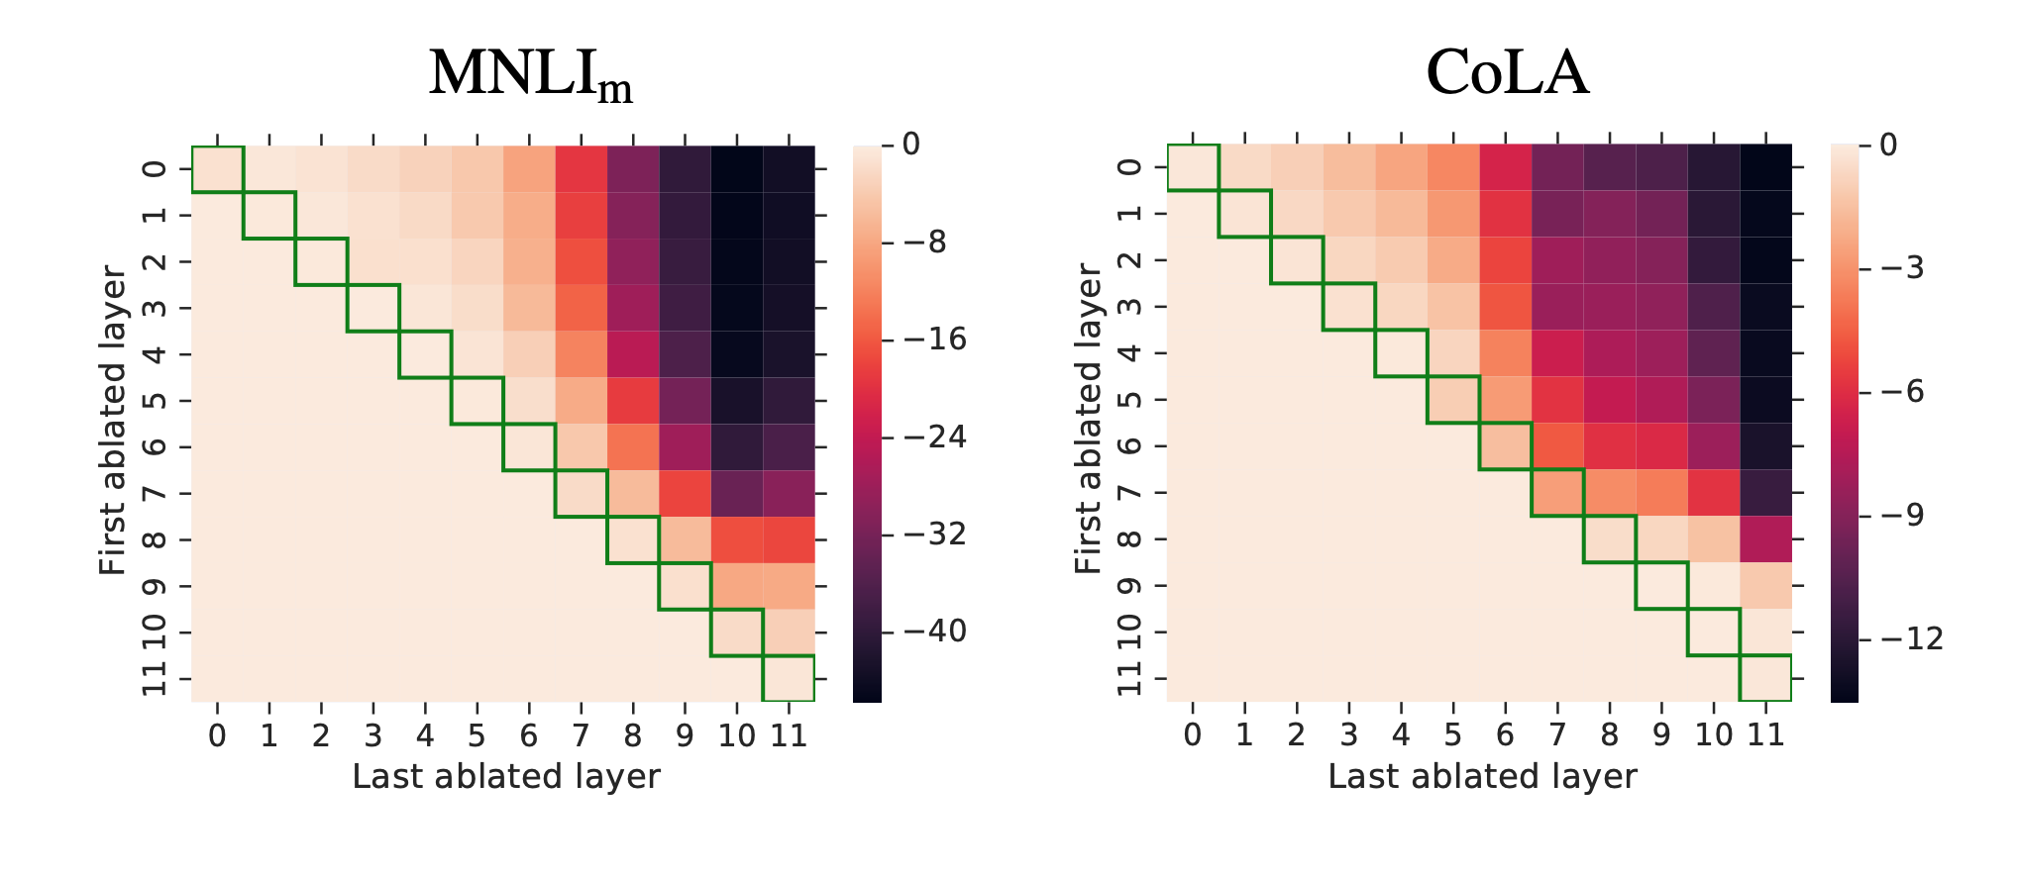
Further analysis - Remove adapters
Removing any single adapter does not cause great decrease
Top layers’ adapters are far more essential

Slide 28
Further analysis - Remarks
Focusing on the upper layers is a popular strategy in fine-tuning (Howard & Ruder, 2018).
One intuition is that the lower layers extract lower-level features that are shared among tasks, while the higher layers build features that are unique to different tasks.
This relates to our observation that for some tasks, fine-tuning only the top layers outperforms full fine-tuning. (section 3.6)

Slide 29
Summary and conclusion
Problem:
  Fine-tuning large pre-trained models for multiple downstream tasks is inefficient as it requires a new model for each task, leading to high parameter redundancy
Innovation:
  Adapter modules are proposed, with only few trainable parameters, allowing more compact models
Results:
  BERT with adapters achieve near state-of-the-art performance on diverse tasks, with only a small increase in parameters updated, compared to full fine-tuning

Slide 30
Discussion
Pros:
  The article is well structured, arguments are clear and convincing
  The coding style is great
  The adapter module is relatively easy to understand and quite intuitive
  This could be useful for gigantic LLMs
Cons:

Slide 31
References - Articles
Devlin, Jacob, et al. BERT: Pre-Training of Deep Bidirectional Transformers for Language Understanding. arXiv:1810.04805, arXiv, 24 May 2019. arXiv.org, https://doi.org/10.48550/arXiv.1810.04805.
Houlsby, Neil, et al. “Parameter-Efficient Transfer Learning for NLP.” Proceedings of the 36th International Conference on Machine Learning, PMLR, 2019, pp. 2790–99. proceedings.mlr.press, https://proceedings.mlr.press/v97/houlsby19a.html.
Vaswani, Ashish, et al. Attention Is All You Need. arXiv:1706.03762, arXiv, 2 Aug. 2023. arXiv.org, https://doi.org/10.48550/arXiv.1706.03762.

Slide 32
References - Github
https://github.com/google-research/adapter-bert/tree/master?tab=readme-ov-file
https://github.com/google-research/bert/tree/master

Slide 33
References - Others (partial)
History of LLM on HuggingFace
Jay Alamar’s The Illustrated Transformers
3Blue1Brown’s videos on deep learning, especially Attention in transformers, visually explained
Randomly collected cat memes
And a bunch of self-study materials I can’t recall…

